Slide 1
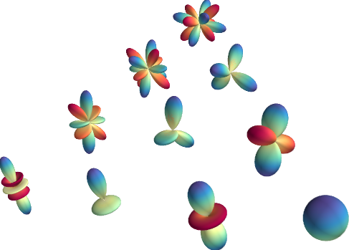
Quantum Machine Learning
Introduction to orbital and spin angular momenta, qubits, and operators on qubits
andrea.droghetti@unive.it

Slide 2
What we are going to see in this lecture
Orbital angular momentum
Spin 1/2 momentum
Qubits
Combination of qubits
Operators on qubits
Measurements of qubits

Slide 3
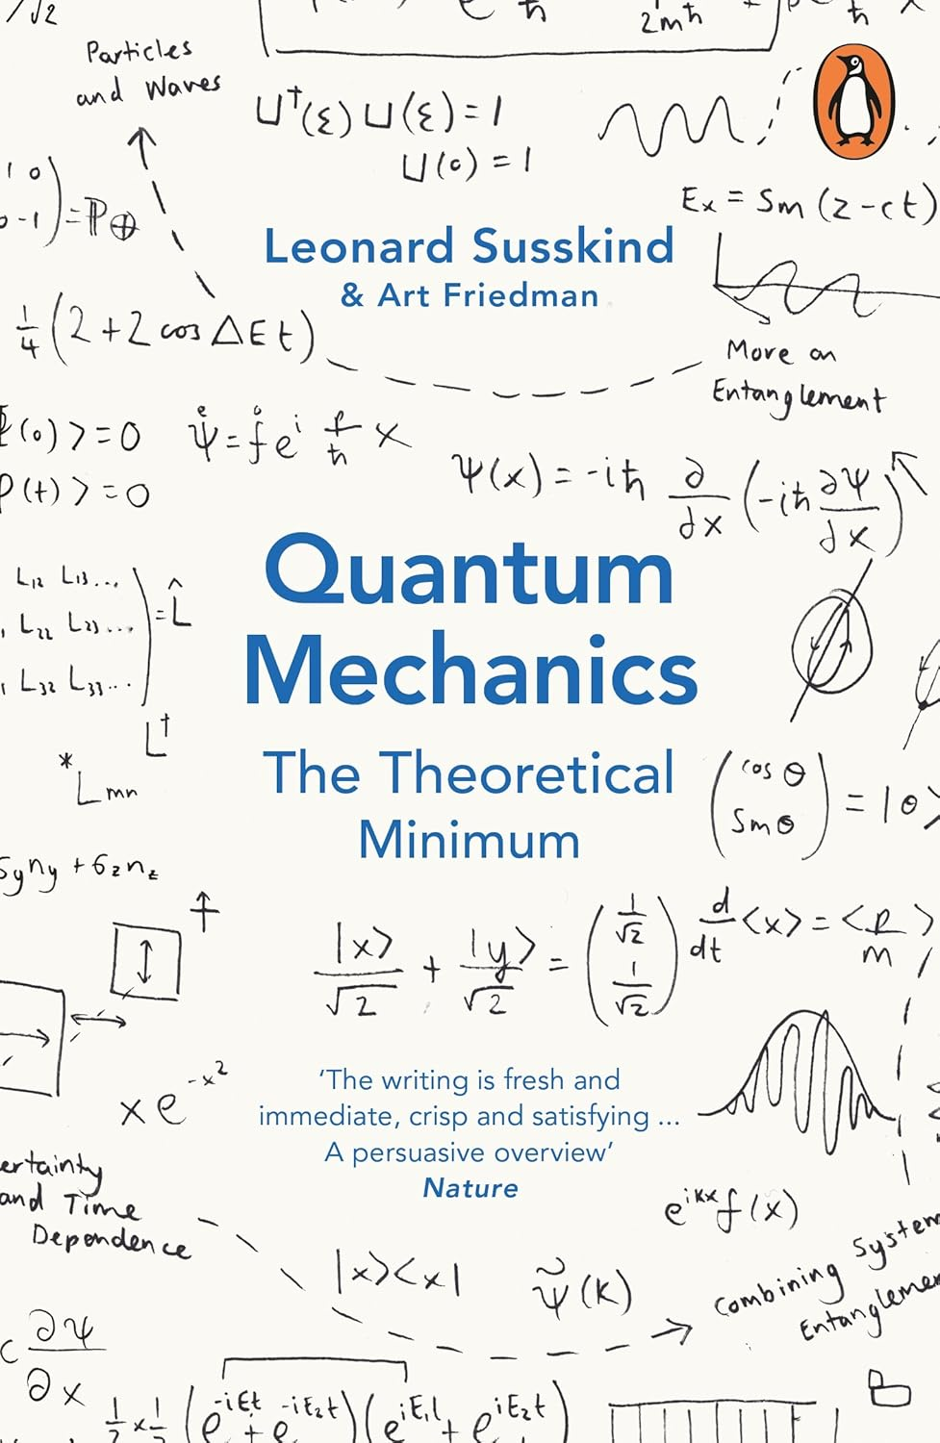
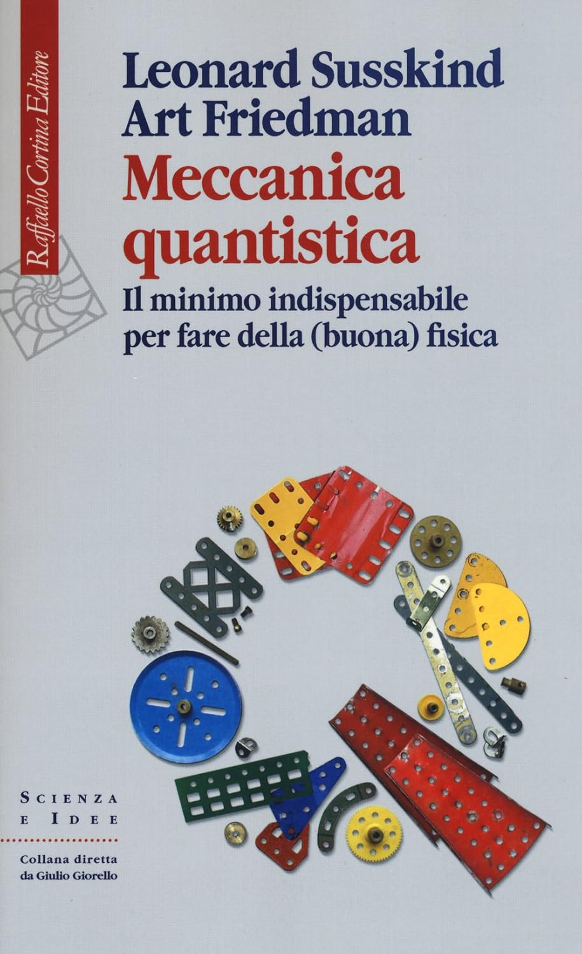
per fare quantum computing

Slide 4

Angular momentum
Angular momentum in classical physics:
If no force is applied, angular momentum is conserved
$$L=r ×p$$

Slide 5

Angular momentum in quantum mechanics
Angular momentum in quantum physics? Operators!

Slide 6

Angular momentum commutators for different components
Position and momentum operators do not commute when they act along the same direction.
x*df(x)/dx is different from d(x*f(x))/dx because the derivative is along the same spatial dimension.

Slide 7
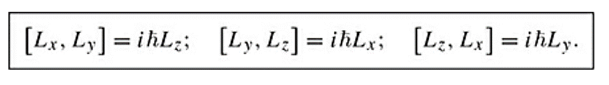
Angular momentum components: general result
If we know one component of the angular momentum (say along the z-direction), then the other two are unknown by a factor proportional to the known component.

Slide 8


Angular momentum: commutator for the modulus L²

Slide 9


Angular momentum: commutator for the modulus L²
It can be shown with identical calculations that L² commutes with every single component of the angular momentum. (Try repeating the calculations above for practice). In other words:
We can measure simultaneously the length of the vector, and one of the components.

Slide 10
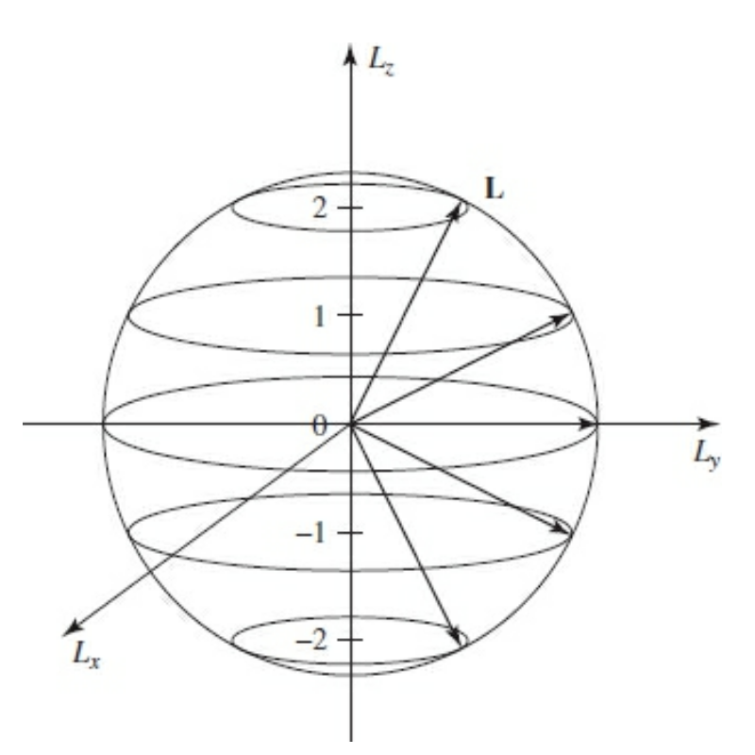
Operator L: eigenvalues and graphical representation
Eigenvalue equation for the modulus:
L²|n,l,m> = l(l+1)ħ²|n,l,m>
Eigenvalue equation for the component:
L_{z}|n,l,m> = mħ|n,l,m>

Slide 11



Commutators between L_{z} and L² and the ladder operators L_{+/–}, defined as:

Slide 12
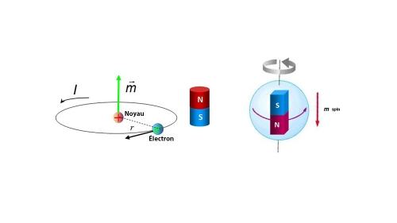
Stern-Gerlach experiment
How to test the quantization of the angular momentum?
If a particle with mechanical angular momentum is charged (such as an electron), it also has a magnetic angular momentum.
L
electron

Slide 13
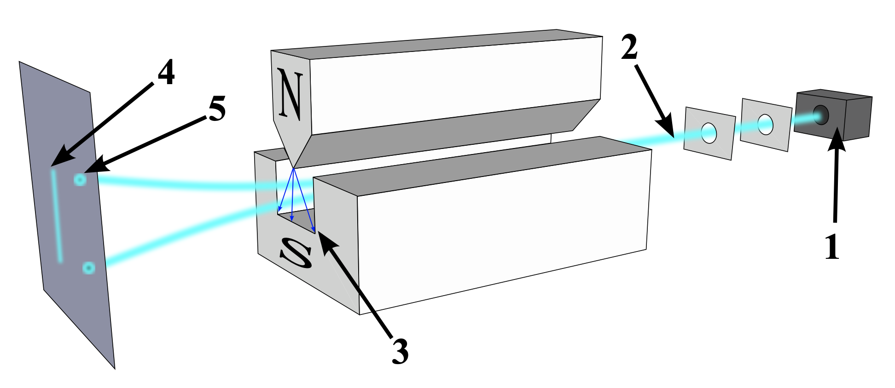
Stern-Gerlach experiments

Slide 14
Stern-Gerlach: expected results
If the angular momentum can have any value (as classical physics would predict), then the deflection would have a continuous set of possible angles.
If the angular momentum is quantized, the deflection in a magnetic field is expected to lead to a set of discrete deflection angles.

Slide 15
Stern-Gerlach:
Stern and Gerlach observed quantized deflections.
https://www.youtube.com/watch?v=PH1FbkLVJU4
https://www.youtube.com/watch?v=rg4Fnag4V-E

Slide 16
Stern-Gerlach (observed results)
Stern and Gerlach observed quantized deflections.
At a closer look, there was a problem though: the number of deflection lines were not consistent with those predicted from the values of the orbital angular momentum.
Experiment with Ag atoms (no orbital angular momentum), but two lines observed.
This apparently discrepancy led to discovery of the electron’s spin.

Slide 17
Concept of spin: analogy
The idea of an electron having internal angular momentum suggests that electrons not only orbit the nucleus but also spin on their own axis.
This is analogous to the Earth not only rotating around the sun, but also “spinning” on itself, i.e., rotating around its axis

Slide 18
Spin: why the classical picture fails
An estimate of the electron's rotational velocity around its own axis suggests that it would exceed the speed of light, violating Einstein's postulate of special relativity.
Spin an observable with no classical analogue.
Eventually, its existence is predicted by combining quantum mechanics with special relativity (Dirac’s equation).

Slide 19


Half integer spin

Slide 20



Half integer spin

Slide 21
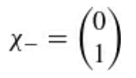




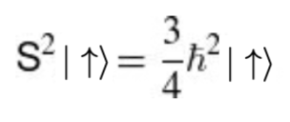
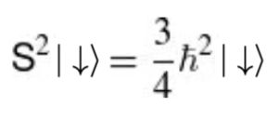
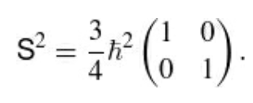
Spin 1/2

Slide 22
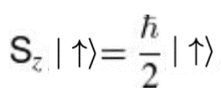
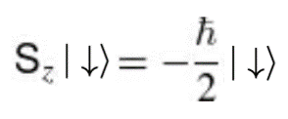
Spin 1/2

Slide 23
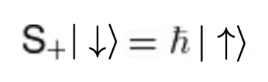


Spin 1/2

